Slide 1

Exploratory Data Analysis: OmniMart Retailers
Uncovering Actionable Insights for Strategic Business Growth
Team: SIGMA BOYS • Date: 2025-09-14
JOY TALUKDAR — Lead Analyst
DEBMALYA DAS — Visualization Specialist
DEVKMAR PAL — Data Engineer
SRINJAN BHAKAT — Report Writer

Slide 2
The EDA Mission Briefing
Objective
Data Source
Key Areas
Analyze transactional data to identify opportunities for enhancing Customer Experience (CX), optimizing product portfolio, and improving operations.
Internal retail_data.csv transaction logs.
Customer Behavior & Segmentation
Product Performance
Operational Efficiency

Slide 3
Data Overview & Preprocessing
Our initial dataset contained 302,010 records across 30 variables, spanning customer demographics, purchase specifics, product information, feedback, and logistics details.
01
02
Initial Assessment
Cleaning Highlights
Identified missing values primarily in Amount/Total_Amount/Ratings and inconsistent date formats.
Rows with critical missing data were dropped. Date fields were standardized, and monetary/rating fields were converted to appropriate numeric types.
This rigorous cleaning ensures data integrity for reliable analysis and actionable insights.

Slide 4

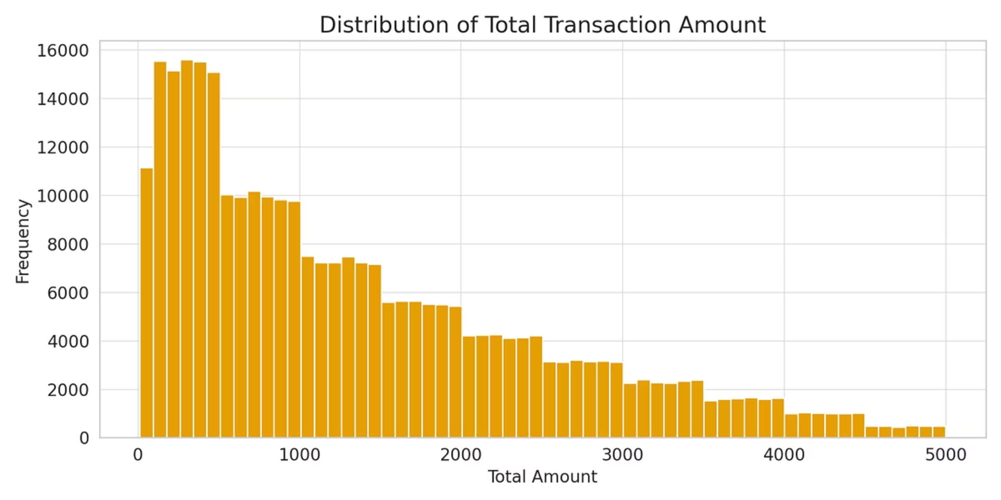
Key Finding 1: Customer Demographics
OmniMart serves a diverse customer base. Analysis of total transaction amount distribution reveals varying spending patterns, including both concentrated groups and high-value outliers. Understanding these demographics is crucial for tailored marketing efforts.

Slide 5

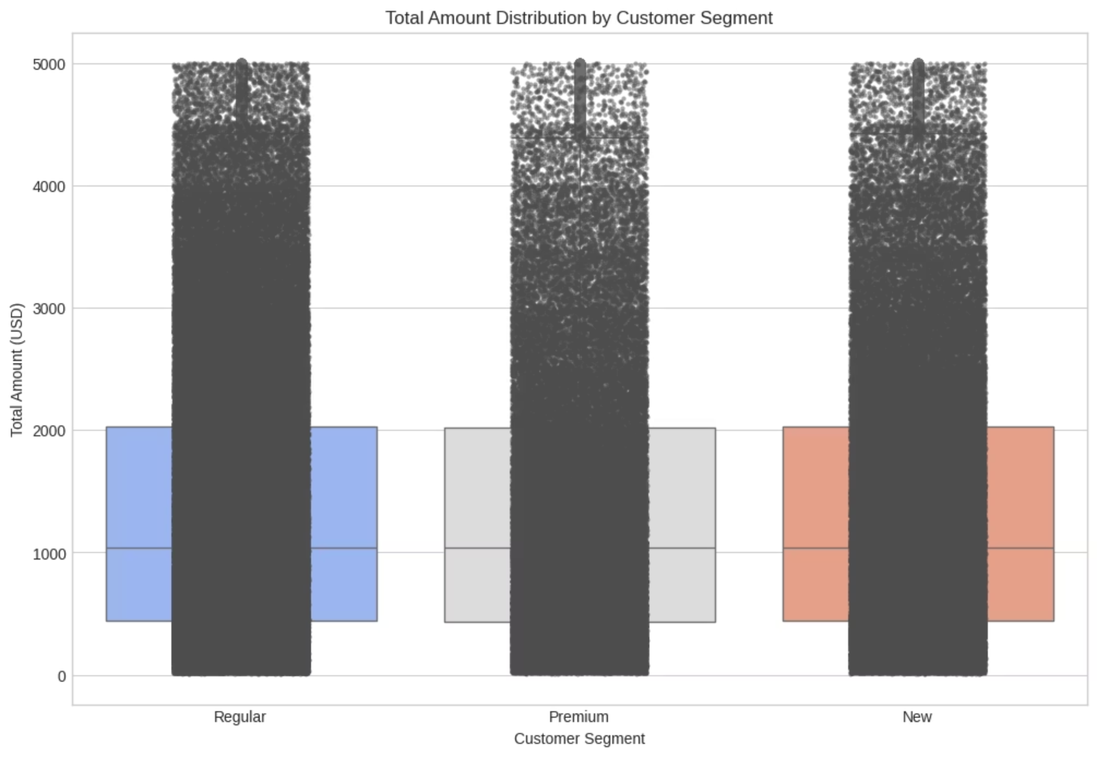
Key Finding 2: Customer Segments & Spending
A deep dive into spending patterns across customer segments highlights that Premium customers exhibit significantly higher median spending and contribute more high-value outliers. This segment represents a key opportunity for targeted engagement and loyalty programs.
The visualization clearly demonstrates the elevated spending of premium customers.

Slide 6

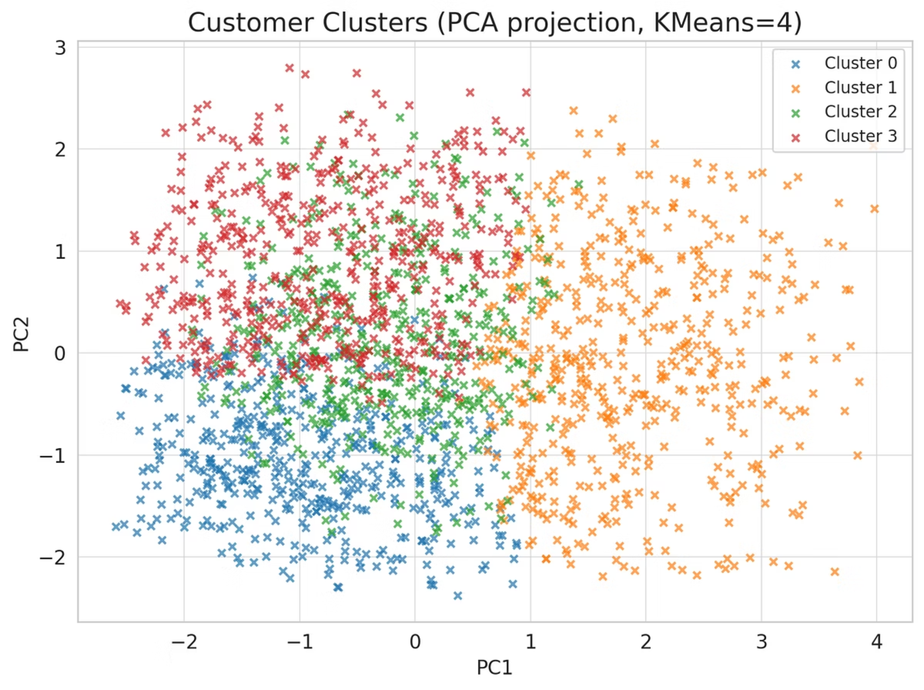
Key Finding 3: Customer Cluster Analysis
Utilizing PCA (Principal Component Analysis) and KMeans clustering, we identified four distinct customer clusters. These clusters are pivotal for developing highly targeted marketing campaigns and personalized customer experiences, moving beyond broad segmentation.
The scatter plot visualizes the separation of these clusters, revealing the underlying patterns in customer behavior.

Slide 7

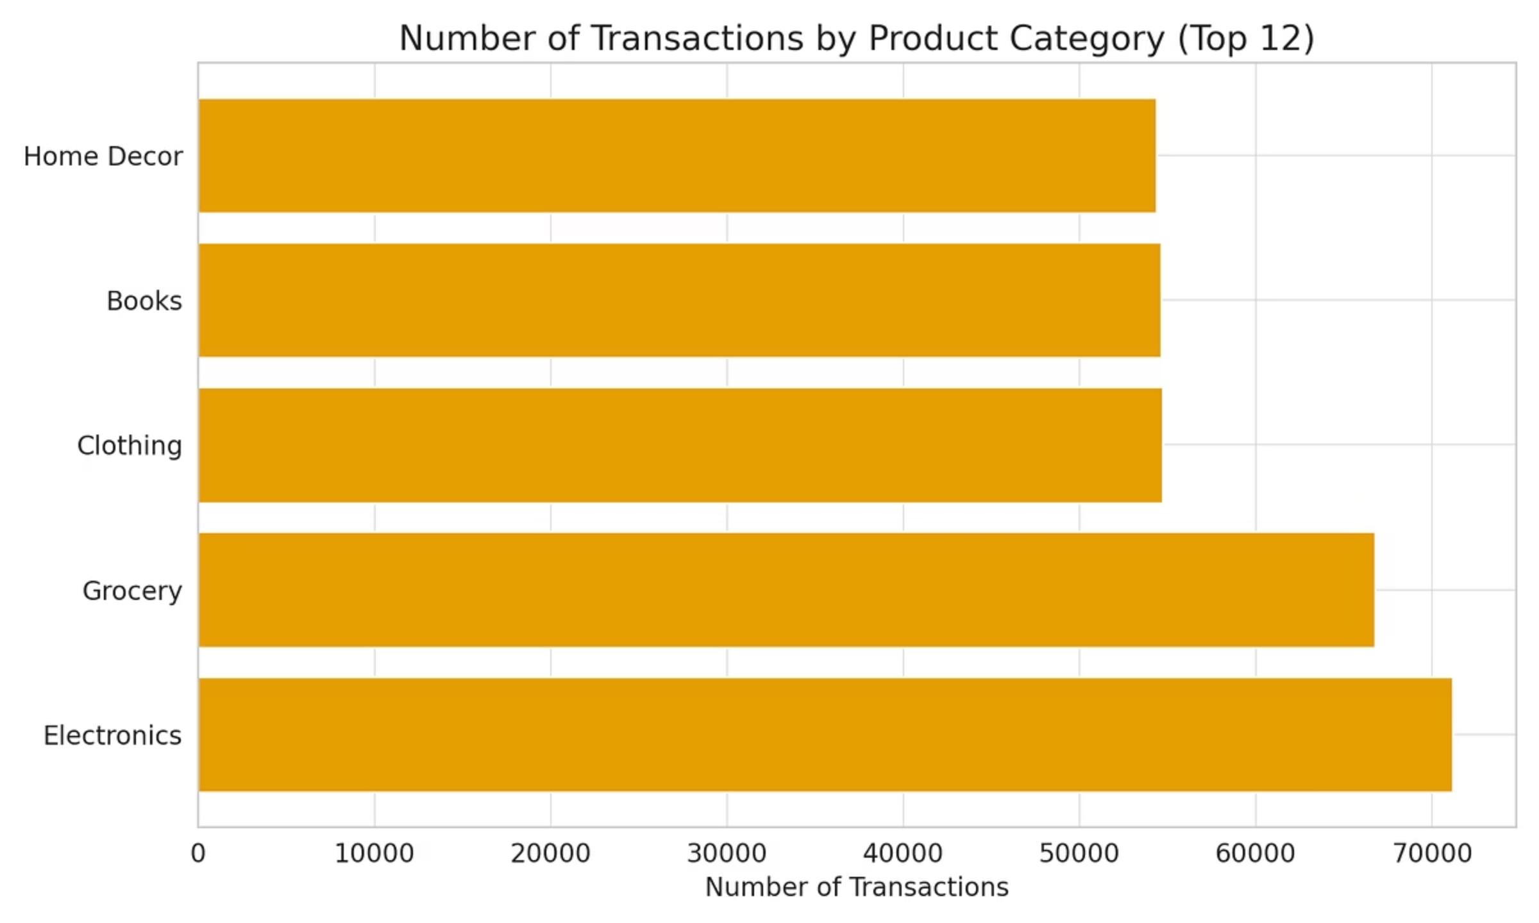
Key Finding 4: Product Performance
While the Grocery category drives significant transaction volume, Electronics and Home Decor categories are notable for generating higher revenue per transaction. This suggests different strategic approaches for inventory management and promotional activities across product lines.
The transaction count per product category highlights Grocery's popularity.

Slide 8
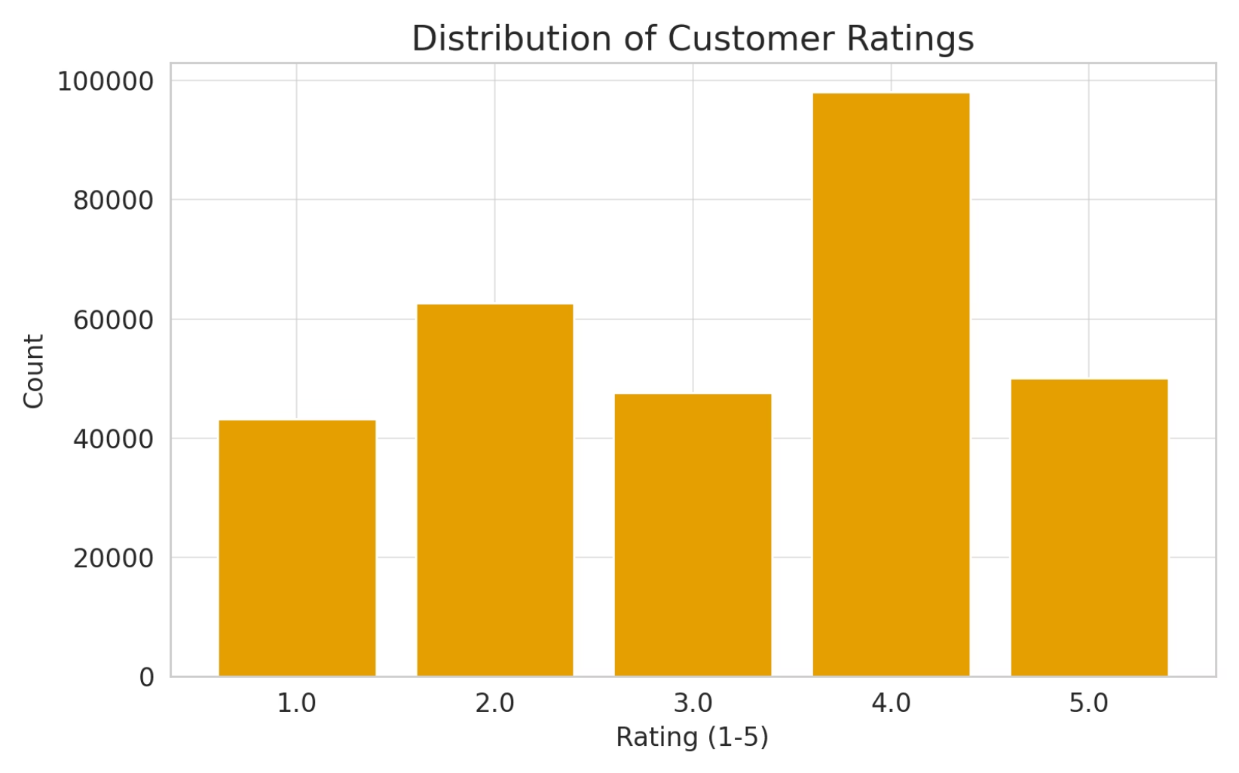
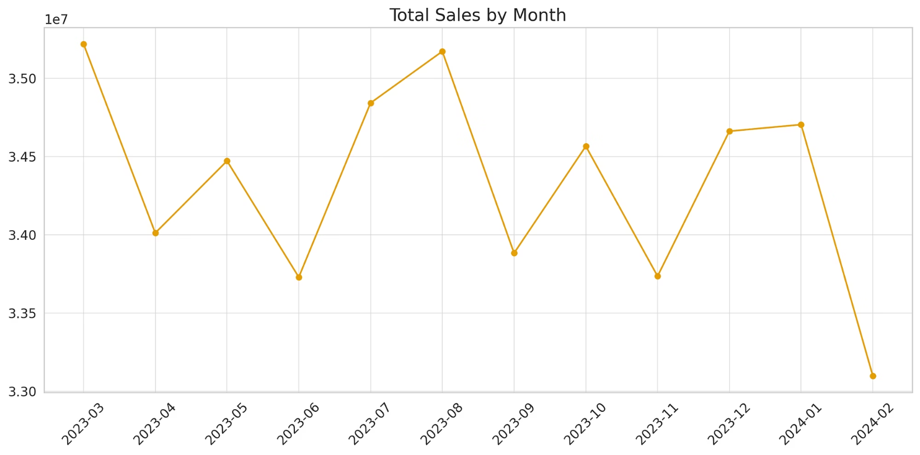
Key Findings 5 & 6: Ratings & Operational Efficiency
A significant number of low ratings (1-2 stars) indicate potential issues with product quality or customer service.
Additionally, our analysis points to fulfillment bottlenecks, particularly with high demand for expedited shipping, impacting overall operational efficiency.

Slide 9
Actionable Strategic Recommendations
1
Optimize Fulfillment Pipeline
2
Refine Customer Segmentation & Marketing
Conduct an audit to reduce Processing/Pending delays, directly improving customer satisfaction and order turnaround times.
Develop loyalty programs and targeted campaigns for high-potential clusters, such as "Low-Income Premium" customers.
3
Two-Pronged Product Review
4
Leverage Top Categories
Investigate whether low ratings are due to product quality or logistics issues before considering product delisting.
Focus promotional efforts and inventory management on Electronics & Home Decor to capitalize on their higher revenue per transaction.

Slide 10

Next Steps & Thank You
Our exploratory analysis has laid a solid foundation. The next phase will focus on predictive modeling and further segmentation to refine strategies.
Next Steps
Deliverables
Predictive modeling (sales forecasting)
analysis.ipynb
Churn analysis
Presentation
Geographic normalization for regional strategies
README.md ready for GitHub submission
Thank you! — SIGMA BOYS

